Slide 1

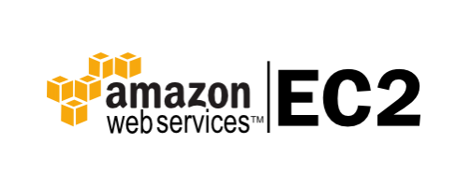

Slide 2

Features:
Bare Metal instances
Pause and Resume Your Instances
GPU Graphics Instances
High I/O Instances
Multiple Locations
Elastic IP Addresses

Slide 3
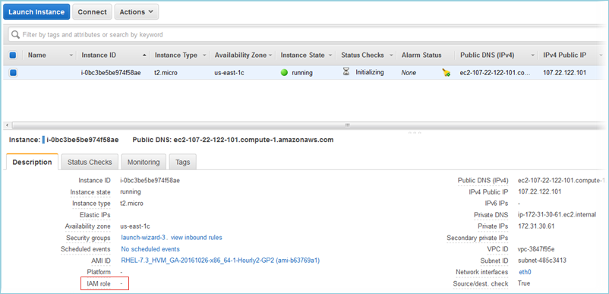

Slide 4





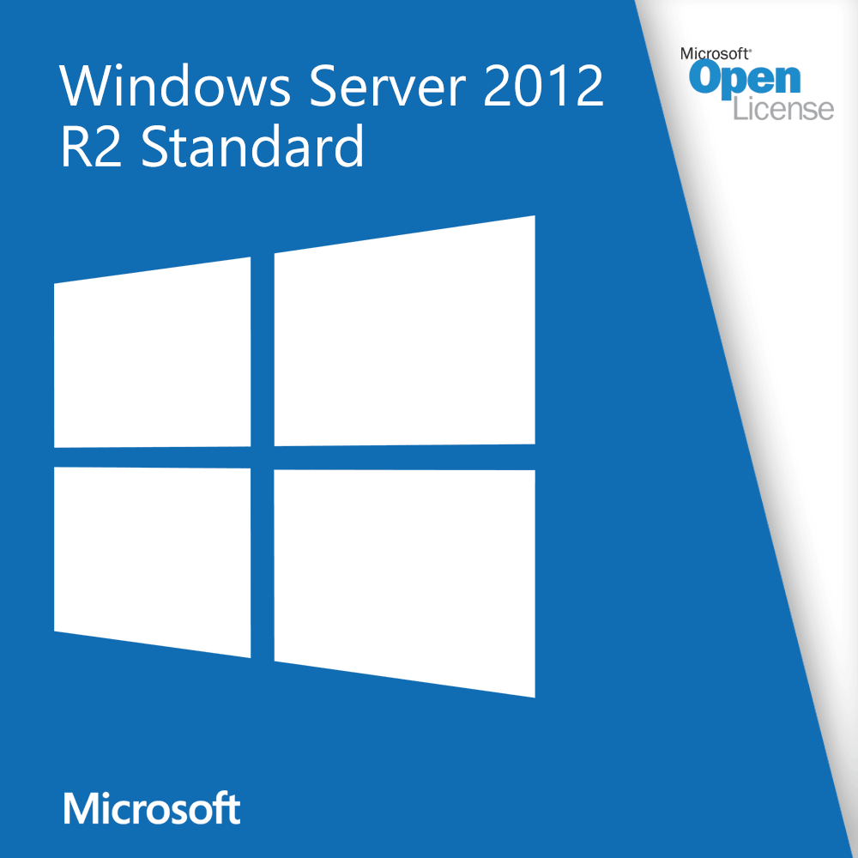

Operating System / Software
Operating System Supported
Software

Slide 5

Benefits of Amazon EC2
Elastic WEB-Scale Computing
Complete Control
Reliable
Secure
Inexpensive
Easy to Start
Migrate from other platform

Slide 6








Featured Customers:

Slide 7
Instance Type
General Purpose
01
Memory Optimized
02
Accelerated Computing
03
Storage Optimized
04
Instance Features
05
Measuring Instance Performance
06

Slide 8
Pricing:
Free Tier
Per Second Billing
AWS Free Tier includes 750 hours of Linux and Windows t2.micro instances each month for one year. To stay within the Free Tier, use only EC2 Micro instances.

